Slide 1
PC165DNR Video Camera
Characteristics and Performance:
Beyond the (Missing) Manual
Ted Swift, IOTA
Davis, California, USA
IOTA 32nd Annual Meeting, 12 July 2014
University of Maryland, College Park, MD

Slide 2
Presentation Outline
Introduction to the PC165DNR Video Camera
  Quick review of Features, Specifications, Controls
Sensitivity Investigation
  Gerhard Dangl’s M67 Still pictures
  Ted Swift’s M67 video footage
Time Response
  Exposure time delay
  Digital Noise Reduction
Spatial Response
  Digital Noise Reduction
Potential for Remote Control
  Hand paddle
  Machine-to-Machine Interface: Arduino

Slide 3
PC165DNR Video Camera
Characteristics and Specifications
Features and Controls
  Integration
  Digital Noise Reduction (DNR; filters in space, time)
  On Screen Display (OSD)
  Row of five Directional buttons on side of camera (Enter, Up, Down, Left, Right).
  “Sense-Up”

Slide 4
PC165DNR Video Camera
Characteristics and Specifications, cont’d
CCD Sensor 1/3” (4.8x3.6mm) SONY Super HAD II
Total Pixels NTSC: 811(H) 508(V), PAL: 795(H) 595(V)
Effective Pixels NTSC: 768(H) 494(V), PAL: 752(H) 582(V)
Scanning System 2:1 interlace
Synchronization Internal
On Screen Display Available
Backlight OFF / HSBLC / BLC selectable
Resolution 600 TV Lines (Color), 650TV Lines (B/W)
S/N (Y signal) 52dB (AGC Off, weight on)
Min. Illumination 0.00001 Lux (B&W, integrating?)
0.001 Lux (Color, integrating?)
White Balance ATW / AWB / Manual / AWC -> SET
Shutter Speed AUTO (1/50 sec, 1/60 sec ~ 1/120,000 s)
Sense-Up Off / Auto (selectable limit *2 ~ *258x)
Gain Control High, Middle, Low, Off selectable
3 DNR Off/On (1~50 level adjustable)
D-WDR Indoor / Outdoor / Off
Motion Detection On / Off (4 zones, alarm output)
Privacy On / Off (8 zones)
[Block bright light sources?]
Gamma ? Not adjustable ?
Mirror Off / Mirror / V-Reverse / Rotate
Freeze On / Off
Sharpness 0~31 (level adjustable)
D&N Selection Color /BW/ Auto
Digital Zoom On (*32) / Off
Blemish Removal Auto: 256 point (even/odd 128 point)
Manual: 4 point
Power Dual voltage: AC 24V or DC 12V
Power Consum. ??? mA
Lens Not Applicable in Astronomy Applications
Operating Temp/ Humid.
14 °F ~ 140 °F (-10 ° C ~ +50 °C).
RH 95% Max.
Storage Temp/ Humid.
4 °F ~ 140 °F (-20 °C ~ +60 °C).
RH 95% Max.
Dimensions 34 mm W, 34 mm H, 51 mm L
(1.34” x 1.34” x 2.0”)
Weight 300 g (0.66 lbs, 10.6 oz.)
Settings stored in non-volatile memory!

Slide 5
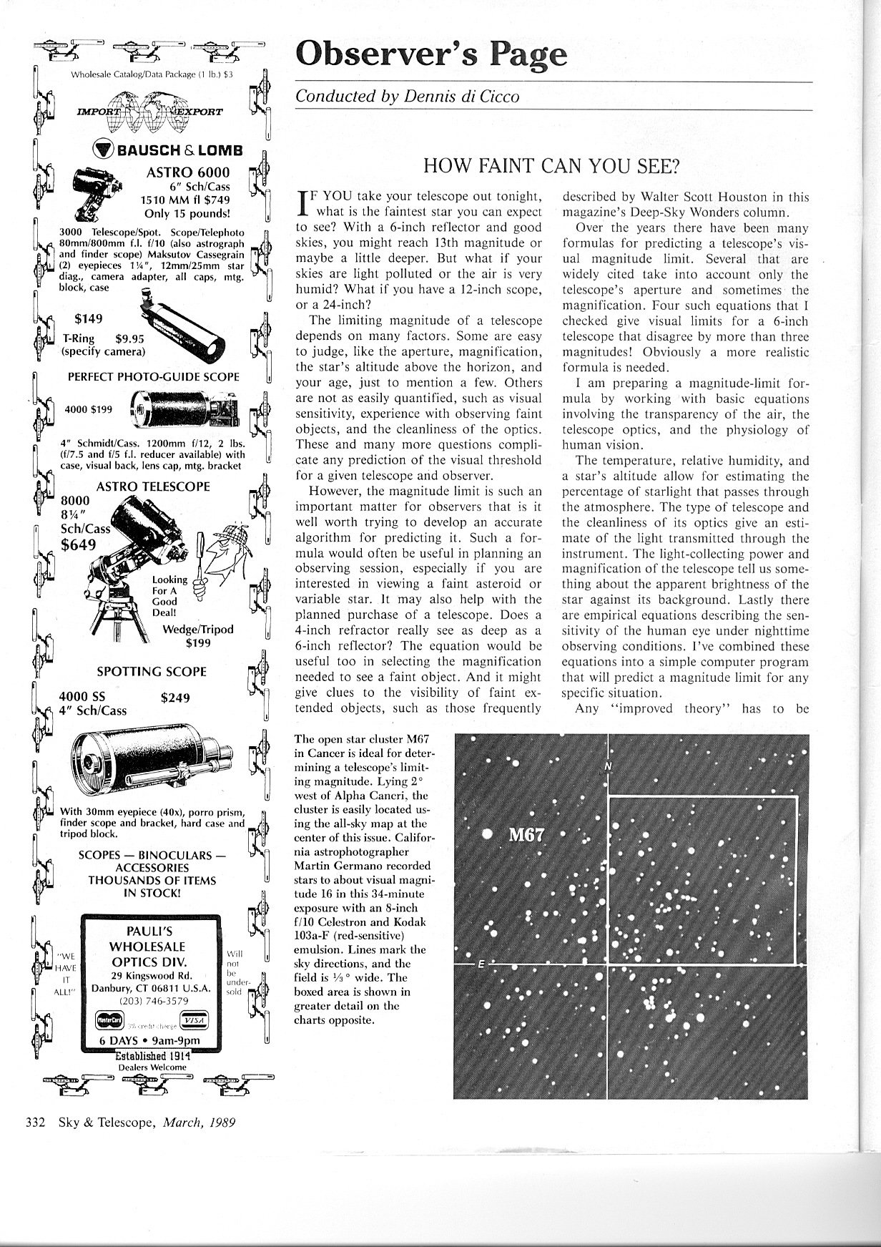
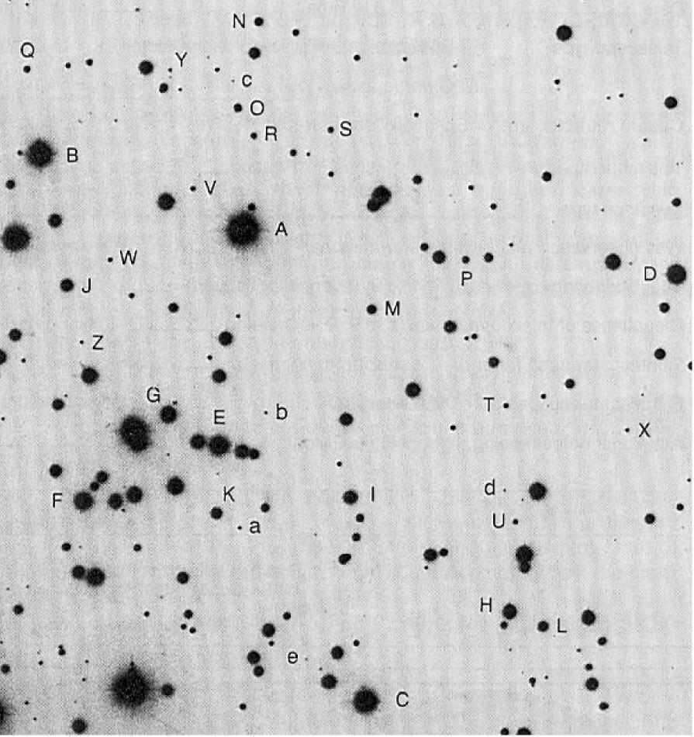
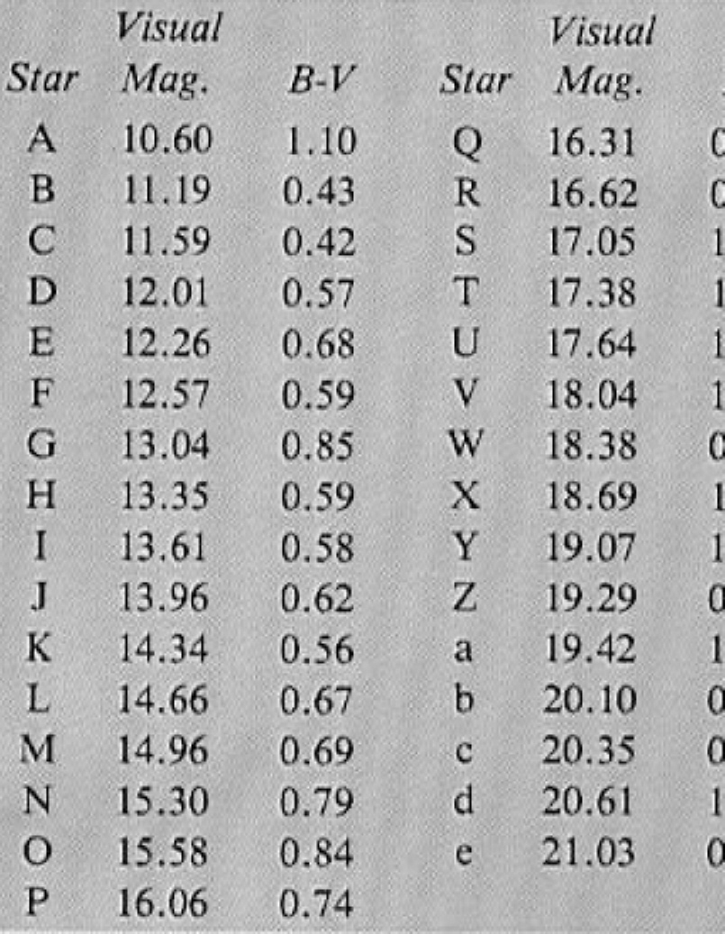
Gerhard Dangl’s Sensitivity Measurements
M67 Photometry: Known star magnitudes
S&T March 1989 p.332.
Similar chart also in RASC Observer’s Handbook.
Notes:
M67 in Cancer is a well-studied star cluster for which detailed photometry and spectroscopic data are available. The NW quadrant has been developed as a set of stars ranging from magnitude 10.6 to 21. Gerhard Dangl collected video of this region in March 2013 for several different camera models, including the PC165DNR.

Slide 6
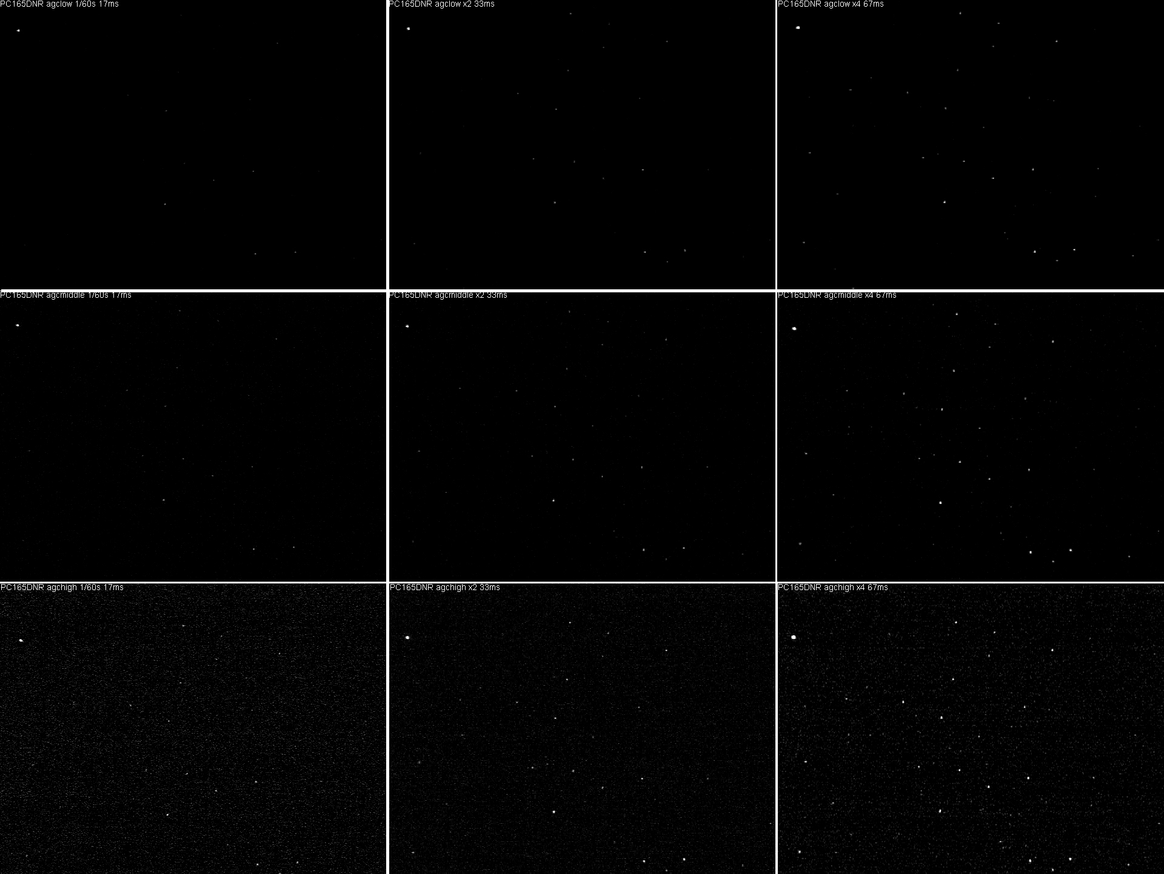
PC165DNR: Gerhard Dangl’s Sensitivity Measurements
M67 in Cancer, 254 mm f/4.7 Newtonian, no glass or filters in optical path, sky +21.2mag/as², 4 Mar 2013. All “fancy settings” turned off (DNR, etc.)
30fps, 17ms
2X, 33ms
4X, 67ms
AGC low
AGC med
AGC high
Notes:
I’ve assembled Gerhard’s still images, taken from video, organized by exposure time and automatic gain control (AGC) setting. This is the first of three pages, working through increasing exposure time. As you may be able to make out, there is a bright star in the upper left corner, and successively more stars are visible with increasing exposure time and AGC setting. Less obvious is that the background noise is higher with higher AGC setting.

Slide 7
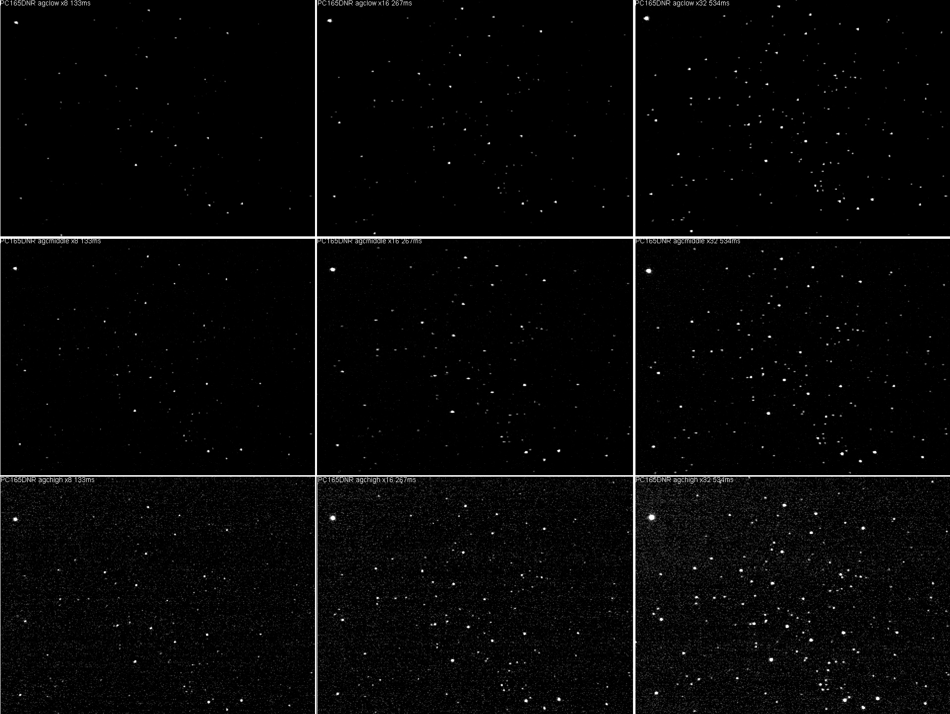
Gerhard Dangl’s Sensitivity Measurements, cont’d.
More stars visible… And more background noise.
8X, 133 ms
16X, 267 ms
32X, 534 ms
AGC low
AGC med
AGC high

Slide 8
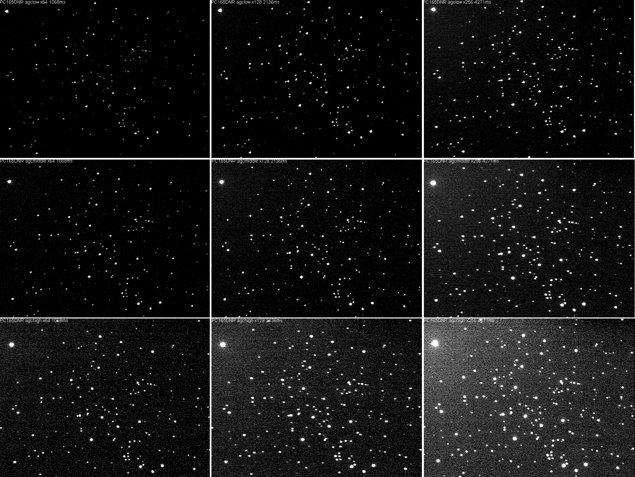
Gerhard Dangl’s Sensitivity Measurements, cont’d.
More stars visible… And even more background noise.
64X, 1068 ms
128X, 2136 ms
256X, 4271 ms
AGC low
AGC med
AGC high

Slide 9
Dangl M67 Image Analysis
Telescope: 254 mm f/4.7 Newtonian.
Values from individual stars visible on stills taken from digitized video.
Subtract ~0.5 mag for 200 mm aperture.
= 1 sec
Notes:
Two plots, presenting the same data but with two different horizontal axes.Maximum difference between AGC ranges is about 1 magnitude. The uncertainties shown attached to the red trace correspond to the differences in the test stars in the table. Note the PC164EX2 is plotted for comparison. In this set of images, it appears to have about 0.5 mag greater sensitivity than the PC165DNR at 30 fps. The PC165DNR overtakes the PC164EX2 for integrations of 4X or greater for AGC > low.

Slide 10
Dangl M67 Image Analysis
Notes:
Here is the “sensitivity anomaly” of the three AGC settings, normalized to 1X exposure time. As with previous graphs, the vertical error bars represent the uncertainty in magnitude due to the limited number of test stars available in Schaefer’s table for M67. Thus, differences less than ~0.4 magnitudes are probably not significant. For example, the peak in the blue AGC=Low trace at 64X is probably due to a range of factors. The AGC=High setting makes a strong start, but then loses apparent sensitivity, probably due to decreasing signal-to-noise at integrations > 16X.

Slide 11
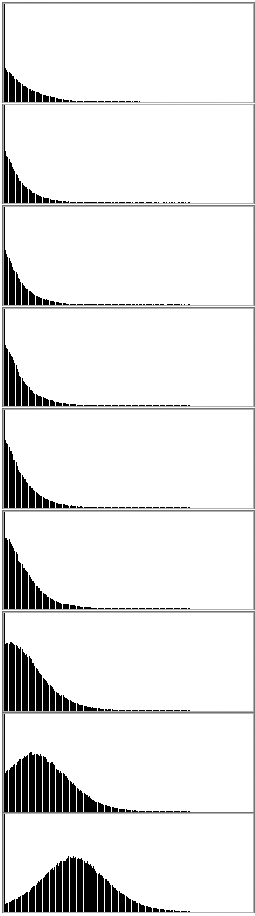
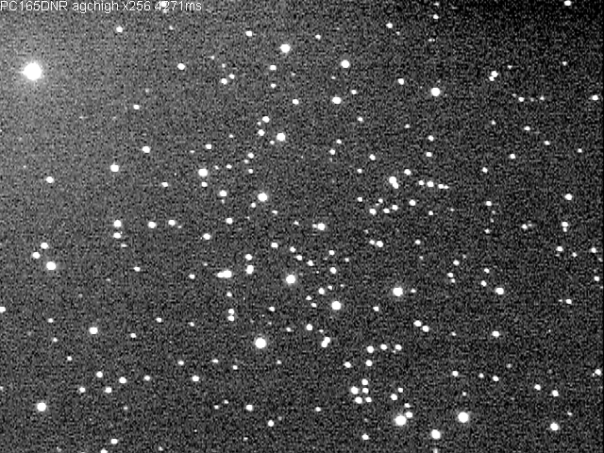
Noise Histogram, AGC High setting
Poisson vs Gaussian Distribution
Exposure | Mean | Median | Std Dev
30 fps | 5.33 | 0 | 13.13
2X | 4.07 | 0 | 10.97
4X | 4.14 | 0 | 11.31
8X | 5.41 | 0 | 13.35
16X | 6.77 | 0 | 15.38
32X | 10.33 | 0 | 18.99
64X | 18.97 | 10 | 24.42
128X | 37.23 | 33 | 31.03
256X | 71.58 | 71 | 35.13
Background Region
(~9,400 pixels)
265X, AGC=High, DNR Off
Theoretical noise distribution
Notes:
I used Photoshop’s Histogram function to quantify the background noise sampled from the upper right corner of each scene, excluding any visible stars. The number of pixels in the selection region was approximately ~9,400, varying slightly from frame to frame. Note that the noise statistical distribution follows a Gaussian distribution, while most literature about the nature of CCD noise says that noise follows a Poisson distribution. Preliminary analysis of snapshots from my own video scenes seemed to show a Poisson-like downward skew to the noise distribution, but I haven’t resolved the cause of the difference. Further analysis in this presentation assumed Gaussian distribution.

Slide 12
Dangl M67 Image Analysis: Noise
Notes:
Noise Floor. Signal-to-Noise Ratio. Note the location of the PC164EX2.

Slide 13
Dangl M67 Image Analysis Interpretation
Camera sensitivity more or less follows 2x increase in sensitivity with 2x increase in exposure time.
Departures from theoretical straight line may be due to measurement fluctuations, limited choice of limiting-magnitude stars from Schaefer’s table, and image interpretation.
That said, noise seems to reduce limiting magnitude for AGC=High by ~1 to 1.5 magnitudes.
Noise is consistently higher at AGC set to High (without DNR; Dangl did not investigate DNR).

Slide 14
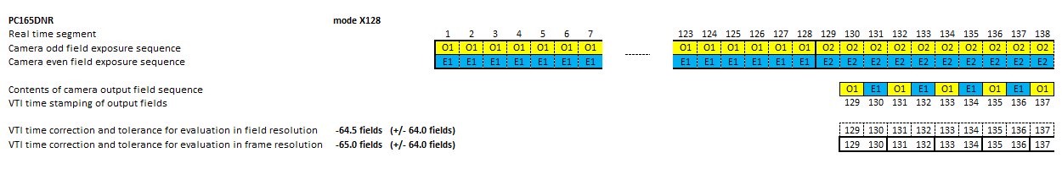
Gerhard Dangl has done a thorough analysis of the PC165DNR’s time delay as a function of integration time (2x, 4x, … 256x). Use it:
http://www.dangl.at/ausruest/vid_tim/vid_tim1.htm#pc165dnr
PC165DNR (EIA)
Mode | Integration time [s] | Correction time [s] |  | “Tolerance value” [s]
 |  | Evaluation in fields (0.017s) | Evaluation in frames (0.033s) | Evaluation in fields (0.017s) | Evaluation in frames (0.033s)
1/60s | 0.017 | -0.017 | -0.017 | ±0.008 | ±0.017
x2 | 0.033 | -0.025 | -0.033 | ±0.017 | ±0.017
x4 | 0.067 | -0.042 | -0.050 | ±0.033 | ±0.033
x8 | 0.134 | -0.075 | -0.083 | ±0.067 | ±0.067
x16 | 0.267 | -0.142 | -0.150 | ±0.134 | ±0.134
x32 | 0.534 | -0.275 | -0.284 | ±0.267 | ±0.267
x64 | 1.068 | -0.542 | -0.551 | ±0.534 | ±0.534
x128 | 2.136 | -1.076 | -1.084 | ±1.068 | ±1.068
x256 | 4.271 | -2.144 | -2.152 | ±2.136 | ±2.136
Notes:
Several people have expressed some confusion about how time delay works with the PC165DNR. It is important to understand that the analog video output signal continues to generate frames at 30 frames per second, 60 fields per second. So any video time-stamp device, such as with a KIWI-OSD or IOTA-VTI, will continue to accurately stamp the time as it arrives at the time inserter. Use Gerhard’s table for time delay corrections.

Slide 15
PC165DNR, DNR Spatial Response
200 mm f/10 SCT w/ f/3.3 FR, PC165DNR. Clear, traces of thin cirrus.
Recorded stars near equator, moving ~15 as/sec. Star Vmag 8.9.
Drift motion: ~2 as/pixel -> 7.5 pix/sec -> 0.25 pix/frame.
Exposure | DNR On/Off | AGC
30 fps | ON | Med
4x | ON | Med
8x | ON | High
16x | ON | Med
16x | OFF | Med
32x | OFF | Med
32X | ON | Med
Still Moving Noise (stretchedx8)
Notes:
Using video collected using my own gear, I’ve started (but far from completed!) a study of the PC165DNR’s Digital Noise Reduction system response to objects moving at siderial rates (satellites will be much faster, of course, depending on magnification). These images were from stills clipped in Photoshop. I limited the study to 32X and less. These images may be suffering from imperfect focus- something to check by repeating the measurements. Worth noting: Slight evidence of diagonal blob shape previously noted in the PC164EX2. Integration smoothes noise (1st arrow); DNR smoothes noise (2nd & 3rd arrow). High AGC is distinctly noisier. Motion obviously tends to smear stars horizontally, noticable at and above 16x (4 pixels). Note odd horizontal bar in several images.

Slide 16
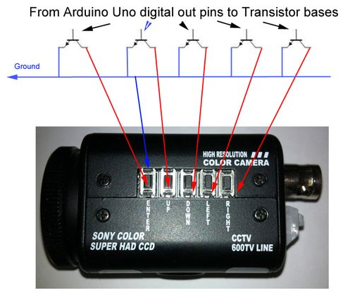
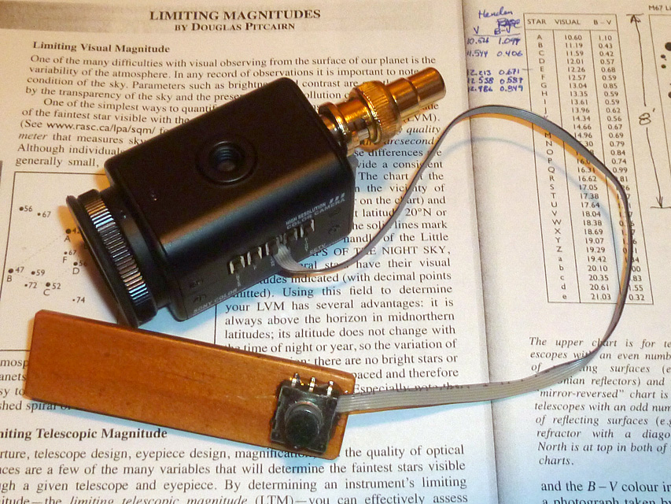
Potential for Remote Control
Hand-paddle development showed that the PC165DNR’s (and perhaps other OSD cameras’?) switches pull down to a common ground connection. This eases two exciting possibilities:
  External “hand paddle” control physically intuitive user interface
  Machine-to-machine control: Automated observatory, remote-control robotic scope
Ted Swift
Kevin Palivec
Notes:
Frustrated with the horizontal OSD button arrangement, I installed an external and more physically intuitive “hand paddle” with a 4-direction rocker switch with center-press “enter”. While investigating the button circuitry, I was happy to find that the buttons are simply pulling a signal line to ground. This (a) made wiring much simpler, but (b) opens up the possibility for a very simple computer-to-camera interface. I soon discovered that Kevin Palivec had independently made the same discovery, and had already developed an Arduino-based remote control system that presents the operator with a web interface. This opens the possibility of controlling all the PC165DNR’s settings remotely, such as in a remotely-controlled occultation scope.

Slide 17
Conclusions & Recommendations
The PC165DNR can detect quite faint sources, applicable to some Trans-Neptunian Object (TNO) occultations.
  mag 12.3 at 30 fps to mag ~17 at 1 frame/4.3 sec on an 25 cm Newtonian
  (or ~11.8 to ~16.5 with a 20 cm scope).
The PC164EX2 is slightly more sensitive than the PC165DNR at 30 fps, but the DNR surpasses the EX2 for integrations greater than 2X (2 fields = 1 frame).
Whenever possible, use AGC=Medium.
  With AGC set to High, image noise is significant. Hot pixels a problem at AGC=High at longer exposures.
Used carefully, DNR may actually be useful.
  Digital noise reduction (DNR) “softens” stars slightly, but reduces background noise at AGC=High.
Use Gerhard Dangl’s tables for integration delay correcton.
Notes:
While there are more expensive cameras that provide integration, have greater sensitivity and better signal-to-noise ratios, the PC165DNR enables observers to reach fainter targets than possible with non-integrating cameras. Using Gerhard Dangl’s images, it appears that the PC164EX2 is slightly more sensitive under close-to-identical camera settings. However, the DNR can reach fainter objects for integrations above 2X (2 fields integrated into one frame). The AGC High setting tends to be very noisy, with many hot pixels evident at longer exposures (only one camera evaluated). More investigation is needed, but for stationary objects, turning DNR on

Slide 18
Conclusions & Recommendations
(With thanks to Tony George’s 2013 IOTA presentation):
Choose the shortest exposure time needed to get a “stable” star, but not less than 1/60 second. This maximizes time resolution.
Use the explicit exposure settings (2x, 4x…) rather than unpredictable “Sense Up” setting.
Gamma appears to be fixed at 0.45 in the PC165DNR.
  Can use gamma correction in LiMovie, etc. (1/0.45 = 2.2).
Use AGC=medium, or AGC=high with care.
Set the PC165DNR to Black&White mode.
OSD cameras may offer the potential for small, inexpensive robotic remote observatories for the “post-Gaia era”.

Slide 19
References and Resources
Gerhard Dangl’s PC165DNR time response analysis
  http://www.dangl.at/ausruest/vid_tim/vid_tim1.htm#pc165dnr
Gerhard’s Video Camera Sensitivity measurements, M67, March 2013
  http://www.dangl.at/menu_hhe.htm , then select Sensitivity Video Cameras, then scroll down to PC165DNR (direct URL doesn’t seem to be available).
Swift, Ted. Feb 2012. A Paddle Control for the PC165DNR. (IOTA Files section), instructions to add an external directional control paddle
  https://xa.yimg.com/df/IOTAoccultations/A+PC165+Directional+Control+Paddle_doc.doc , found in
  https://groups.yahoo.com/neo/groups/IOTAoccultations/files/Ted%20Swift%27s%20files/
Test of the Watec 120N Video Camera : Another chart of M67 http://www.astrosurf.com/buil/watec120n/test.htm
Kevin Palivec’s Instructable plans to remotely control the PC165DNR with an Arduino microcontroller found at:
  http://www.instructables.com/id/Adding-remote-OSD-button-control-to-the-SuperCircu/?ALLSTEPS

Slide 20
References, continued
Good FAQ explaining much of the jargon related to these cameras, and the pros and cons of the features: http://www.eaglevision1.com/security_camera_FAQ.htm
Manufacturer’s documents
  pc165dnr-quickstartguide-sc.pdf, pc165dnr-datasheet-sc.pdf
Cameras with very similar specifications, with links to their respective manuals, which provide better documentation (though still terse) than the Super Circuits PC165-DNR “quick start manual”.
  http://www.securitycamera2000.com/products/600TVL-SONY-SUPER-HAD-CCD-D%252dWDR-Color-Board-Camera-with-OSD-Menu-DNR.html
Manual linked from above:
  http://www.securitycamera2000.com/download/PZ0420-User-Manual.pdf
  http://www.supercircuits.com/media/docs/blk-cpt235vh2-manual-do.pdf
Same camera(?):
  http://www.digiop.com/files/documents/Digiop_Black_HighPerformance_Bullet_Cameras.pdf
  http://www.supercircuits.com/media/docs/blk-cpt235vh2-manual-do.pdf

